Slide 1
Genetics
Bhavya Guduru
Chapters 16-17

Slide 2
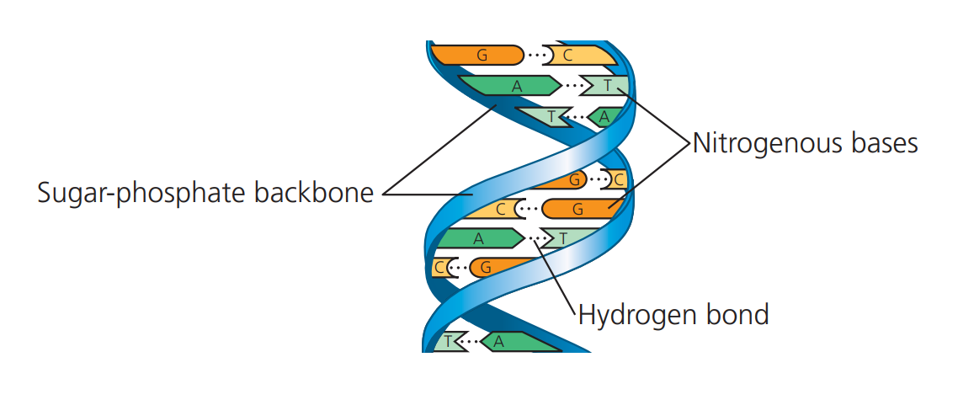
Genetic Material
Genetic Material:
Evidence came from experiments with bacteria and phages
DNA Structure: double helix
Antiparallel sugar phosphate + nitrogenous bases
Nitrogenous Bases Pairs:
Use hydrogen bonds between purine + pyrimidine (too wide otherwise)
Chargaff’s Rules: A = T and C = G.
Amounts are the same
DNA
A + T and G + C

Slide 3
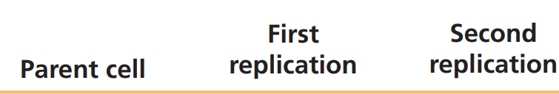
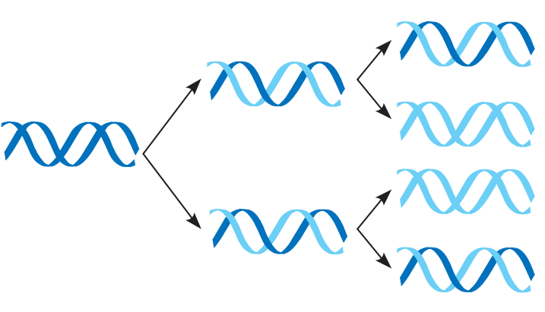
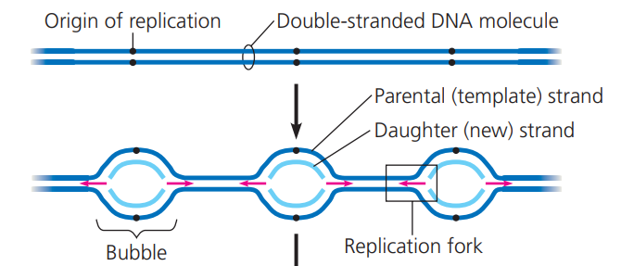
DNA Replication
Semiconservative Model: two strands of parental molecule separate, and each function as a template for synthesis of a new complementary strand
Origin of Replication: replication starts; one in bacteria multiple in eukaryotes
Replication Fork: Y shape were new strands of DNA elongate and arise since replication can occur in both directions from origin
DNA Polymerases: enzyme that adds nucleotides
along template strand of new DNA

Slide 4
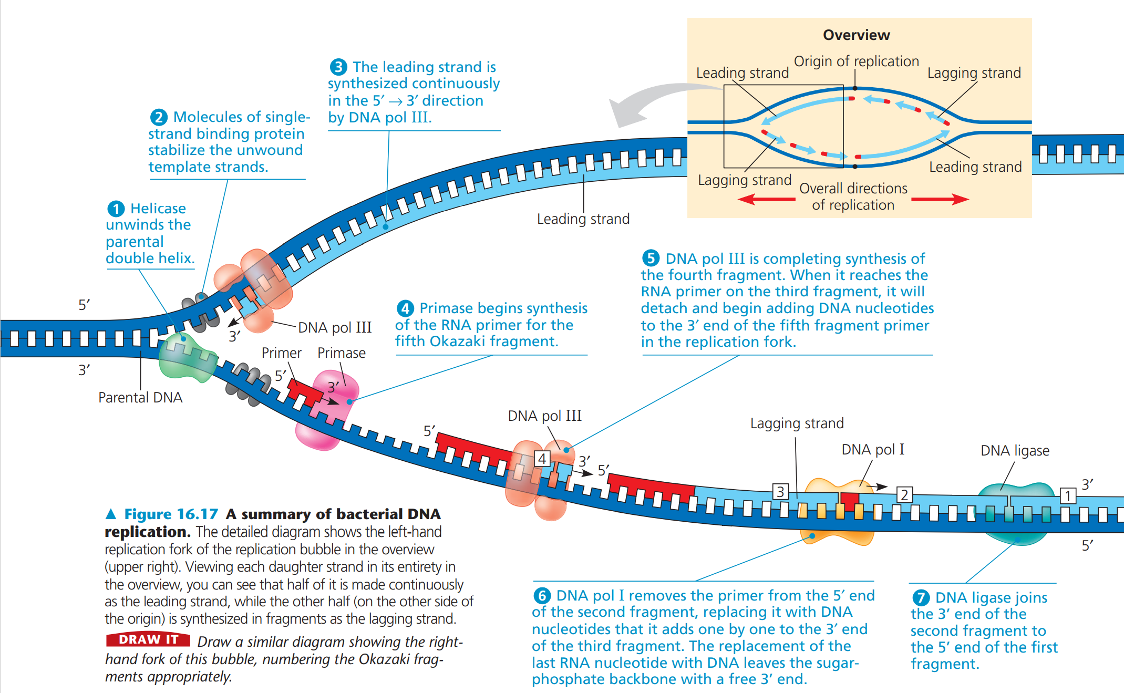
DNA Replication
Leading: towards
Lagging: away
Okazaki Fragments: joined via DNA ligase
Primer: starts nucleotide chain, made by primase
*Topoisomerase: relieves stress caused by helicase

Slide 5
DNA Proofreading and Repairing
DNA polymerases proofread each nucleotide against template
If error, immediately removes nucleotide and continues
Mismatched Nucleotides: arise after DNA synthesis or if DNA polymerase misses it
Special enzymes to fix incorrectly paired nucleotides
Examples: chemicals, radioactive emissions, X-rays, UV rays → changes in DNA to mutations
Nucleotide Excision Repair:
Nuclease: enzyme cuts out damaged DNA
Filled in with proper nucleotides and sealed

Slide 6
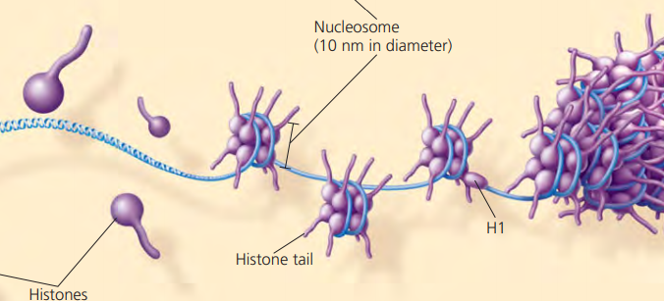
DNA & Packing
Chromosomes: Made up of DNA and incredibly condensed
Bacterial: circular DNA with proteins making up the nucleoid of cell
Chromatin: uncoiled vs. Chromosome: coiled and condensed
Histones: proteins that help with first level of packing; usually positive charged due to certain amino acids (?) which allow it to attract and bind tightly to DNA (-)
Nucleosome: DNA wound twice around a protein core with 8 histones total
Leads to highly condensed chromatin for the metaphase chromosome so during interphase, chromatin varies
Heterochromatin: highly condensed
Euchromatin: less compact; accessible for transcription

Slide 7
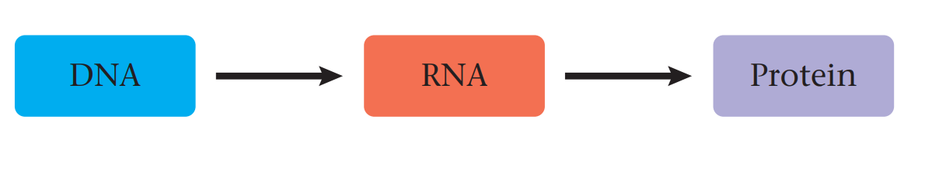
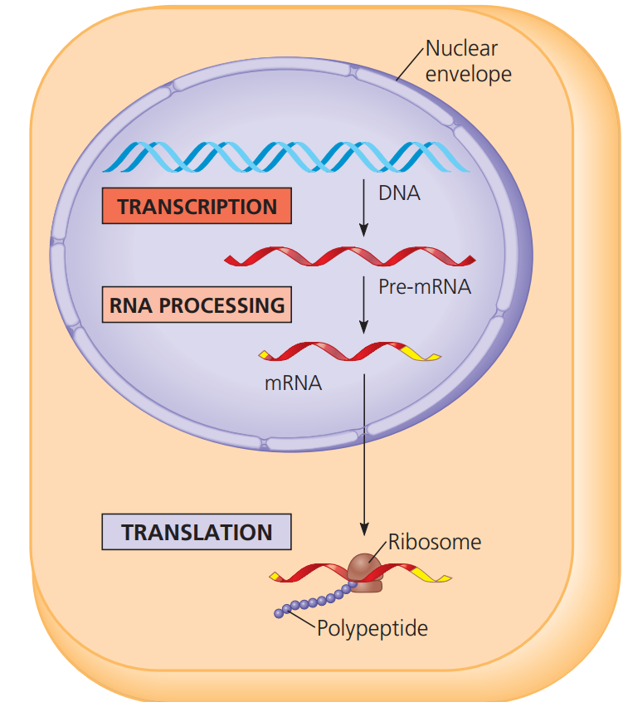
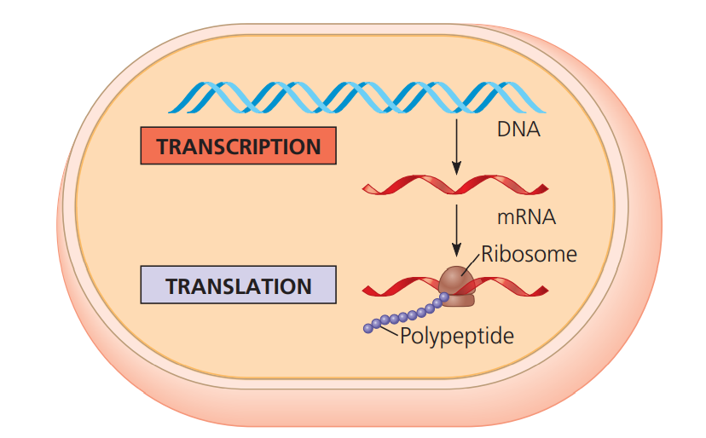
Central Dogma
DNA controls metabolism by directing cells to make specific enzymes and other proteins via Gene Expression
Transcription: synthesis of RNA complementary to template strand of DNA; nucleotide transfer of info
Translation: synthesis of polypeptide who amino acid sequence is specified by the nucleotide sequence in mRNA; nucleotides to amino acids
Codons: nucleotide triplets where genetic information is encoded
Translated into amino acid or serves stop signal
Prokaryotes vs Eukaryotes

Slide 8
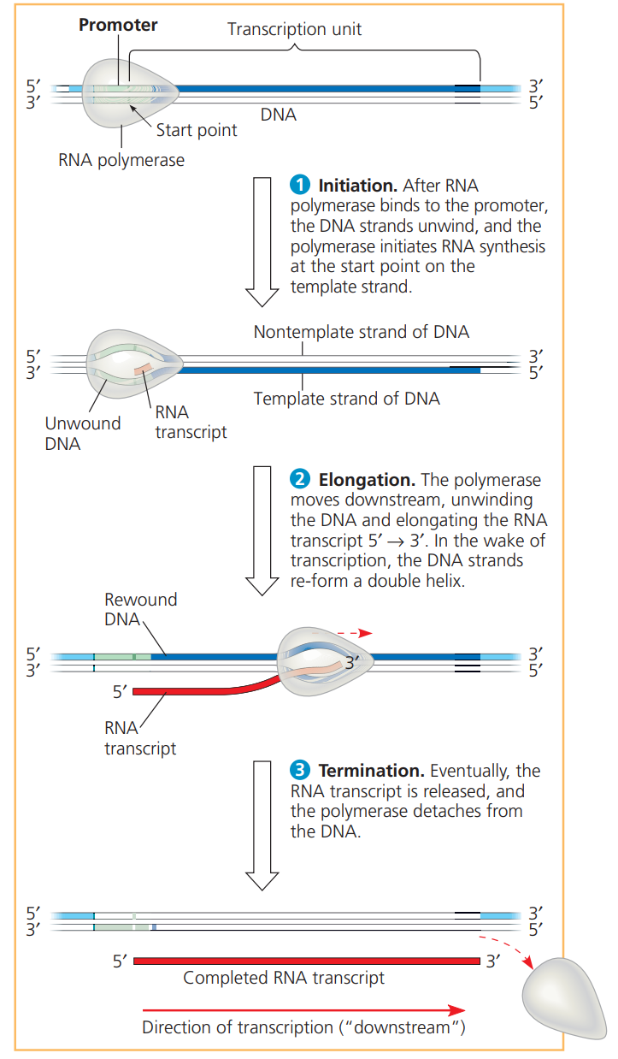
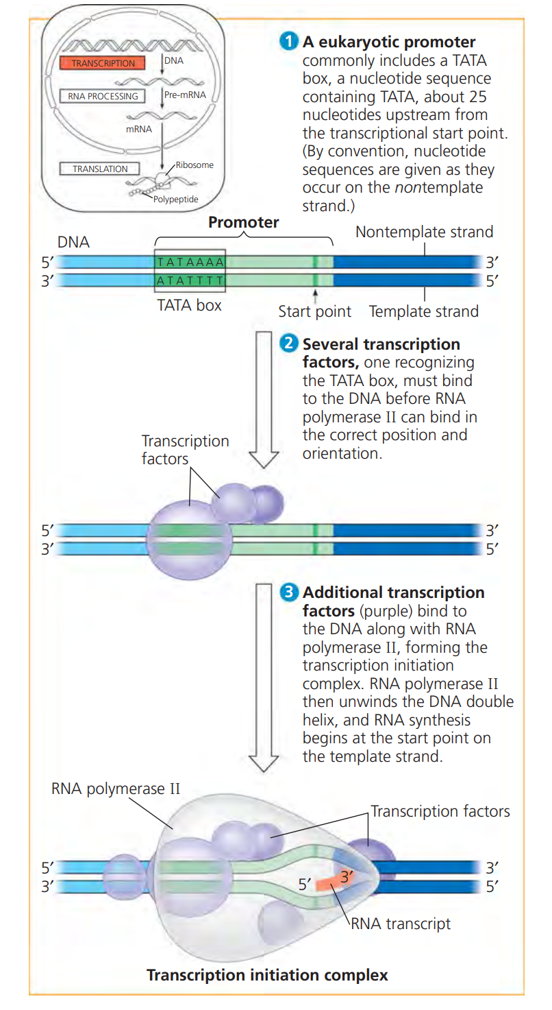
Transcription
Initiation, Termination, Elongation
Eukaryotes Transcription Initiation

Slide 9
Eukaryotic Modification
Eukaryotic mRNA molecules undergo RNA processing BEFORE leaving nucleus
Alteration of mRNA ends:
5’ end receives a 5’cap (made of guanine)
3’ end receives a poly-A tail (made of adenine)
Facilitate export of mRNA from nucleus; protect mRNA from degradation by hydrolytic enzymes, help ribosomes to attach to 5’ end of mRNA
Alternative RNA splicing
Most eukaryotic genes and their RNA transcripts have long noncoding stretches of nucleotides
Noncoding regions = Introns Coding Regions = Exons
Introns are cut out and exons are joined together
Small nuclear ribonucleoproteins (snRNPs): recognize splice sites
snRNPs + other proteins = spliceosome
RNA can start its own splicing → ribozymes (RNA molecules that act as enzymes)

Slide 10
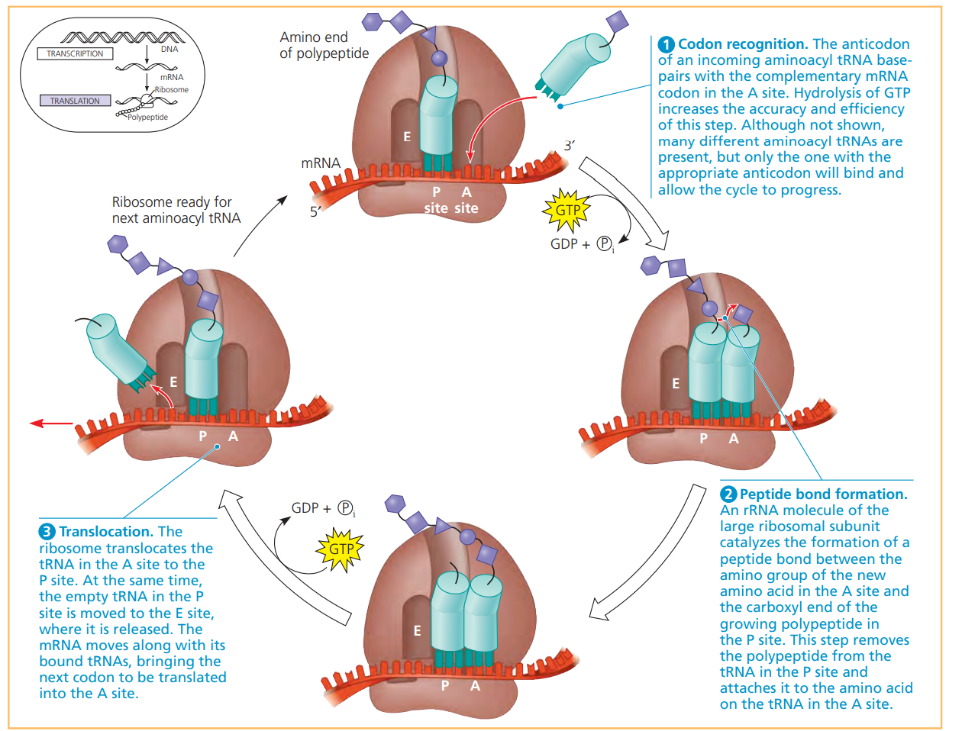
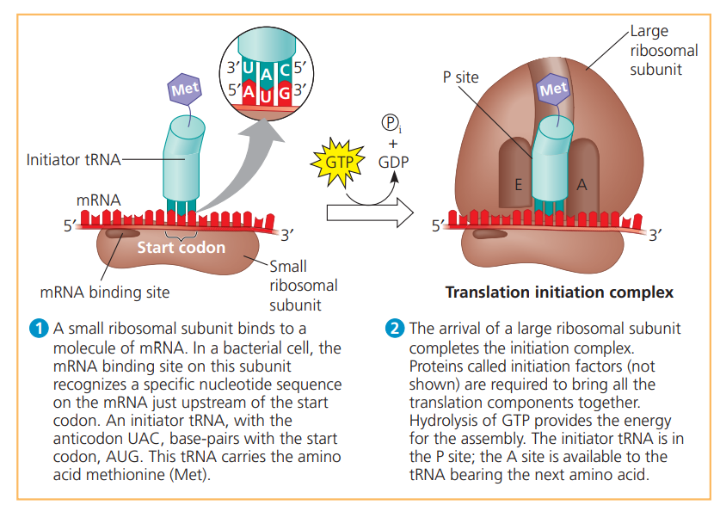
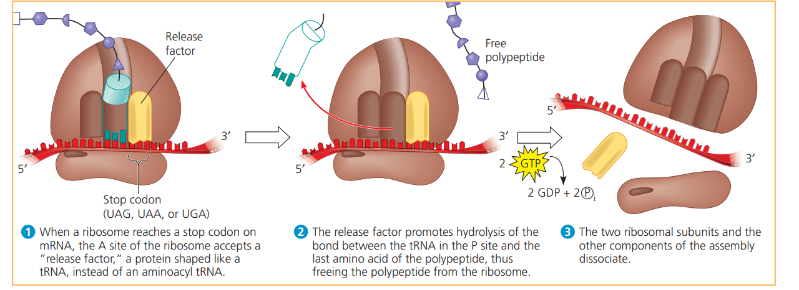
Translation: Initiation, Elongation, Termination

Slide 11
Mutations
Point Mutations: changes in a single nucleotide pair of a gene
Can lead to production of nonfunctional proteins ex: sickle cell disease
Nucleotide Pair Substitution: replacement of one nucleotide and its partner with another pair
Some have no effect due to redundancy of genetic code ex: GGC and GGU both code glycine!
Example of a silent mutation: no observable effect on phenotype
Missense Mutation: change amino acid to another
Little effect to major effect
Nonsense Mutation: change codon for amino acid to become stop codon
Translation ends early and nonfunctional protein results
Insertion / Deletions: additions / losses of nucleotide pairs in gene
More catastrophic effect than substitutions
Alter reading frame of genetic message (triplet grouping)
Frameshift Mutation: occur whenever number of nucleotides inserted/deleted is not multiple of three

Slide 12
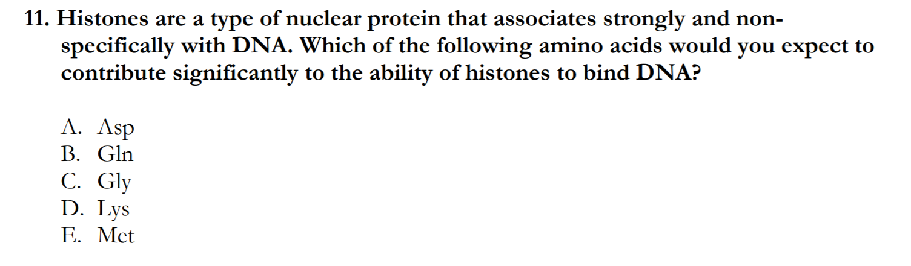
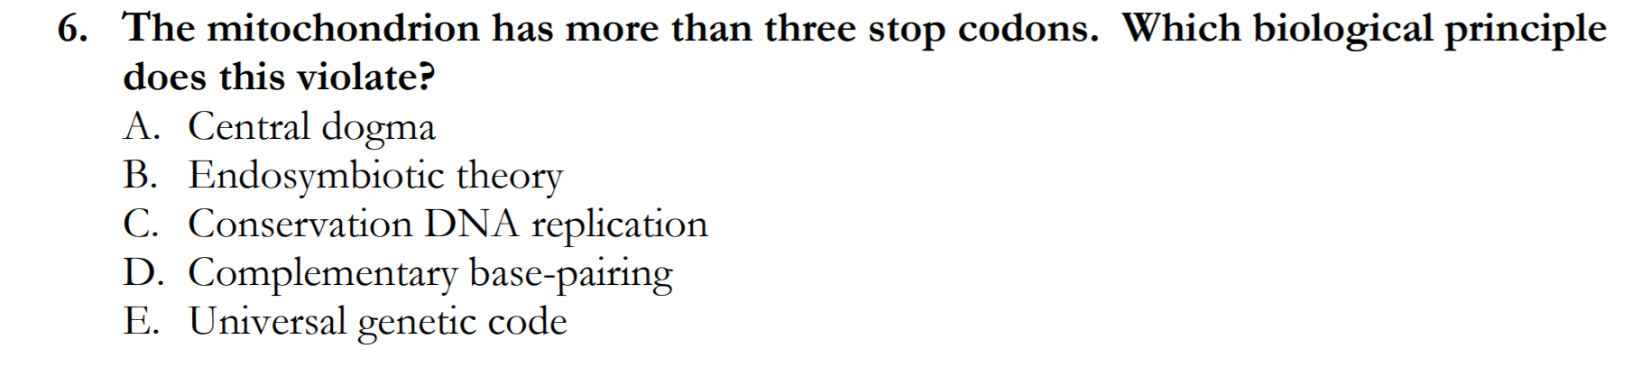
Practice
D
E
Notes:
D) DNA is negatively charged! So histones can bind only if they have positively charged amino acids including: arginine, lysine, histidine
E) univerasl genetic code (codon has three things so it can code for amino acid!)

Slide 13
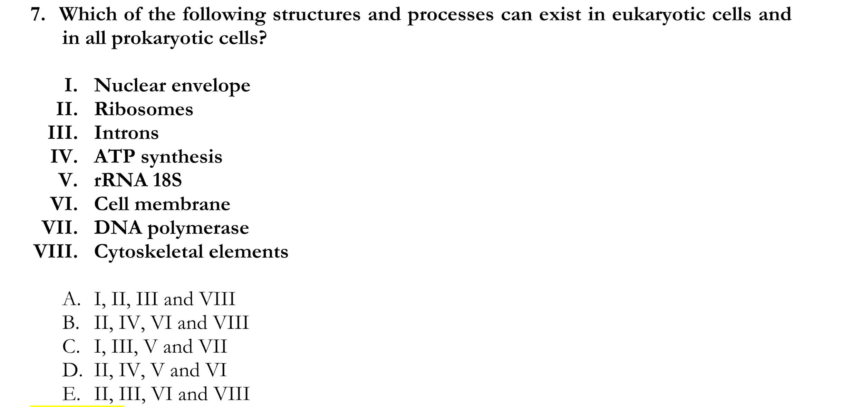
Practice
D
Notes:
D
Nuclear envelope eukaryotes only
Both
Eukaryotes only! Alternative splicing
ATP synthesis → both need it!
rRNA yes to code it!
Cell membrane!!! Both have it
Dna polymerase eukaryotes
Cytoskeleton eukaryotes only!

Slide 14
Thank you!

